Slide 1
Carry-over effects of temperature and pCO₂ across multiple Olympia oyster populations
Temperature
60 days, winter
pCO₂
52 days,
winter
Volitionally spawn
60 days, spring
Offspring reared (6°C only) common conditions, 1 year
Survival tested in 4 locations
90 days, summer
↑ parental pCO₂ = ↑ offspring survival, dependent on location
841 µatm
6°C
841 µatm
↑ temperature = ↑ larvae,
↑ pCO₂ counteracts
6°C
841 µatm
1. Fidalgo Bay
2. Port Gamble Bay
✳︎✳︎
a
b
a
b
✳︎✳︎
✳︎✳︎
b
100-
75-
50-
25-
0-
a
b
6°C
✳︎✳︎
1045 µatm
6°C
1045 µatm
6°C
1045 µatm
✳︎✳︎
✳︎✳︎
✳︎✳︎
Percent Survival
a
ab
ab
4 genetically distinct groups
✳︎✳︎
No. larvae per adult
↑ temperature = earlier larval release
N
↑
10°C
841 µatm
3. Skokomish Delta
4. Case Inlet
841 µatm
a
100-
75-
50-
25-
0-
a
a
a
a
✳︎✳︎
✳︎✳︎
a
10°C
b
✳︎✳︎
10°C
1045 µatm
Percent Survival
1045 µatm
b
✳︎✳︎
✳︎✳︎
No. days to peak larval release
Parents in treatment
Parents, offspring in common conditions
Offspring in field trial

Slide 3
Apr. 11, 2017
June 2013
Dec. 6, 2016
Adults conditioned, spawned,
90 days
Oct. 4, 2017
F, D, and O-1 cohorts produced
Temperature exposure,
60 days
6ºC juveniles moved to Clam Bay for winter
June 2015
Feb. 16, 2017
May 11, 2017
June 12, 2018
O-2 cohort produced from O-1
pCO₂ exposure, 52 days
Larvae counted,
60 days
Subset reared
6ºC juveniles deployed in 4 bays,
86 days
Feb. 4, 2017
Apr. 8, 2017
Gonad sampled
Gonad sampled
841 µatm pCO₂
Common conditions (hatchery)
1ºC daily increase to 18ºC to spawn
Larvae reared at 18ºC
Common conditions
(Clam Bay)
Fidalgo Bay
6ºC
Cohorts in common conditions (Clam Bay) before exposures
3045 µatm pCO₂
Port Gamble Bay
Environmental conditions
841 µatm pCO₂
10ºC
Skokomish River Delta
3045 µatm pCO₂
Case Inlet
Adults
Offspring

Slide 5
Cumulative larvae released
by cohort x treatment
No. larvae, per adult oyster
No. days spawning
6°C / Ambient
10°C / Ambient
6°C / High
10°C / High

Slide 6
b
ab
a
ab
a
a
b
b

Slide 7
a
b
a
b
a
a
a
a

Slide 9
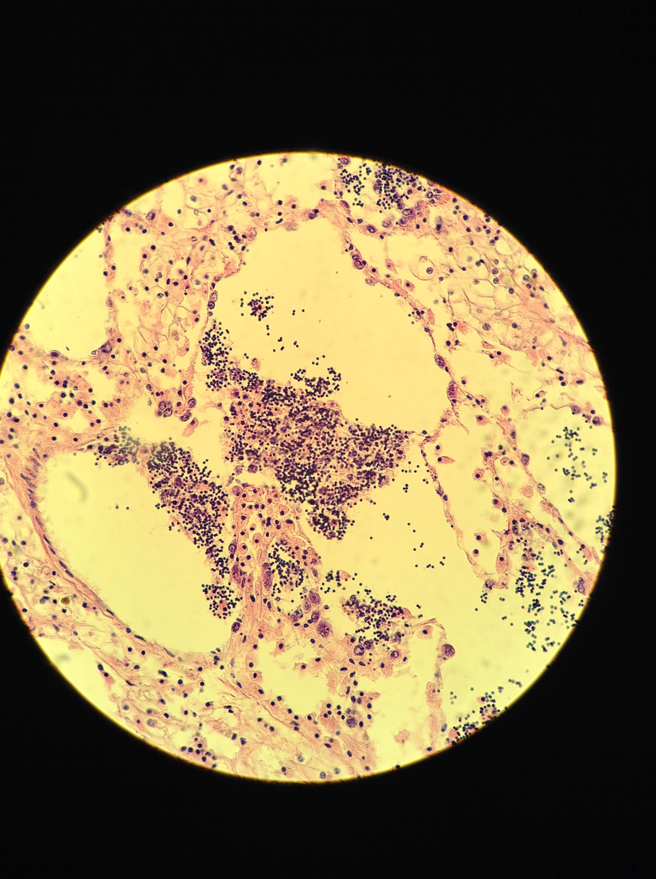
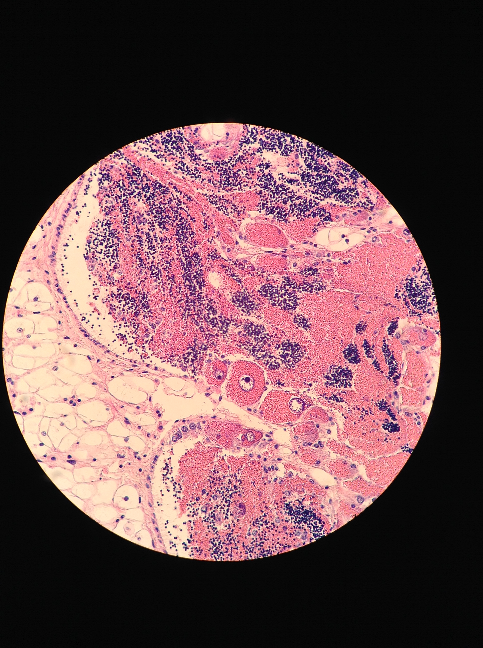
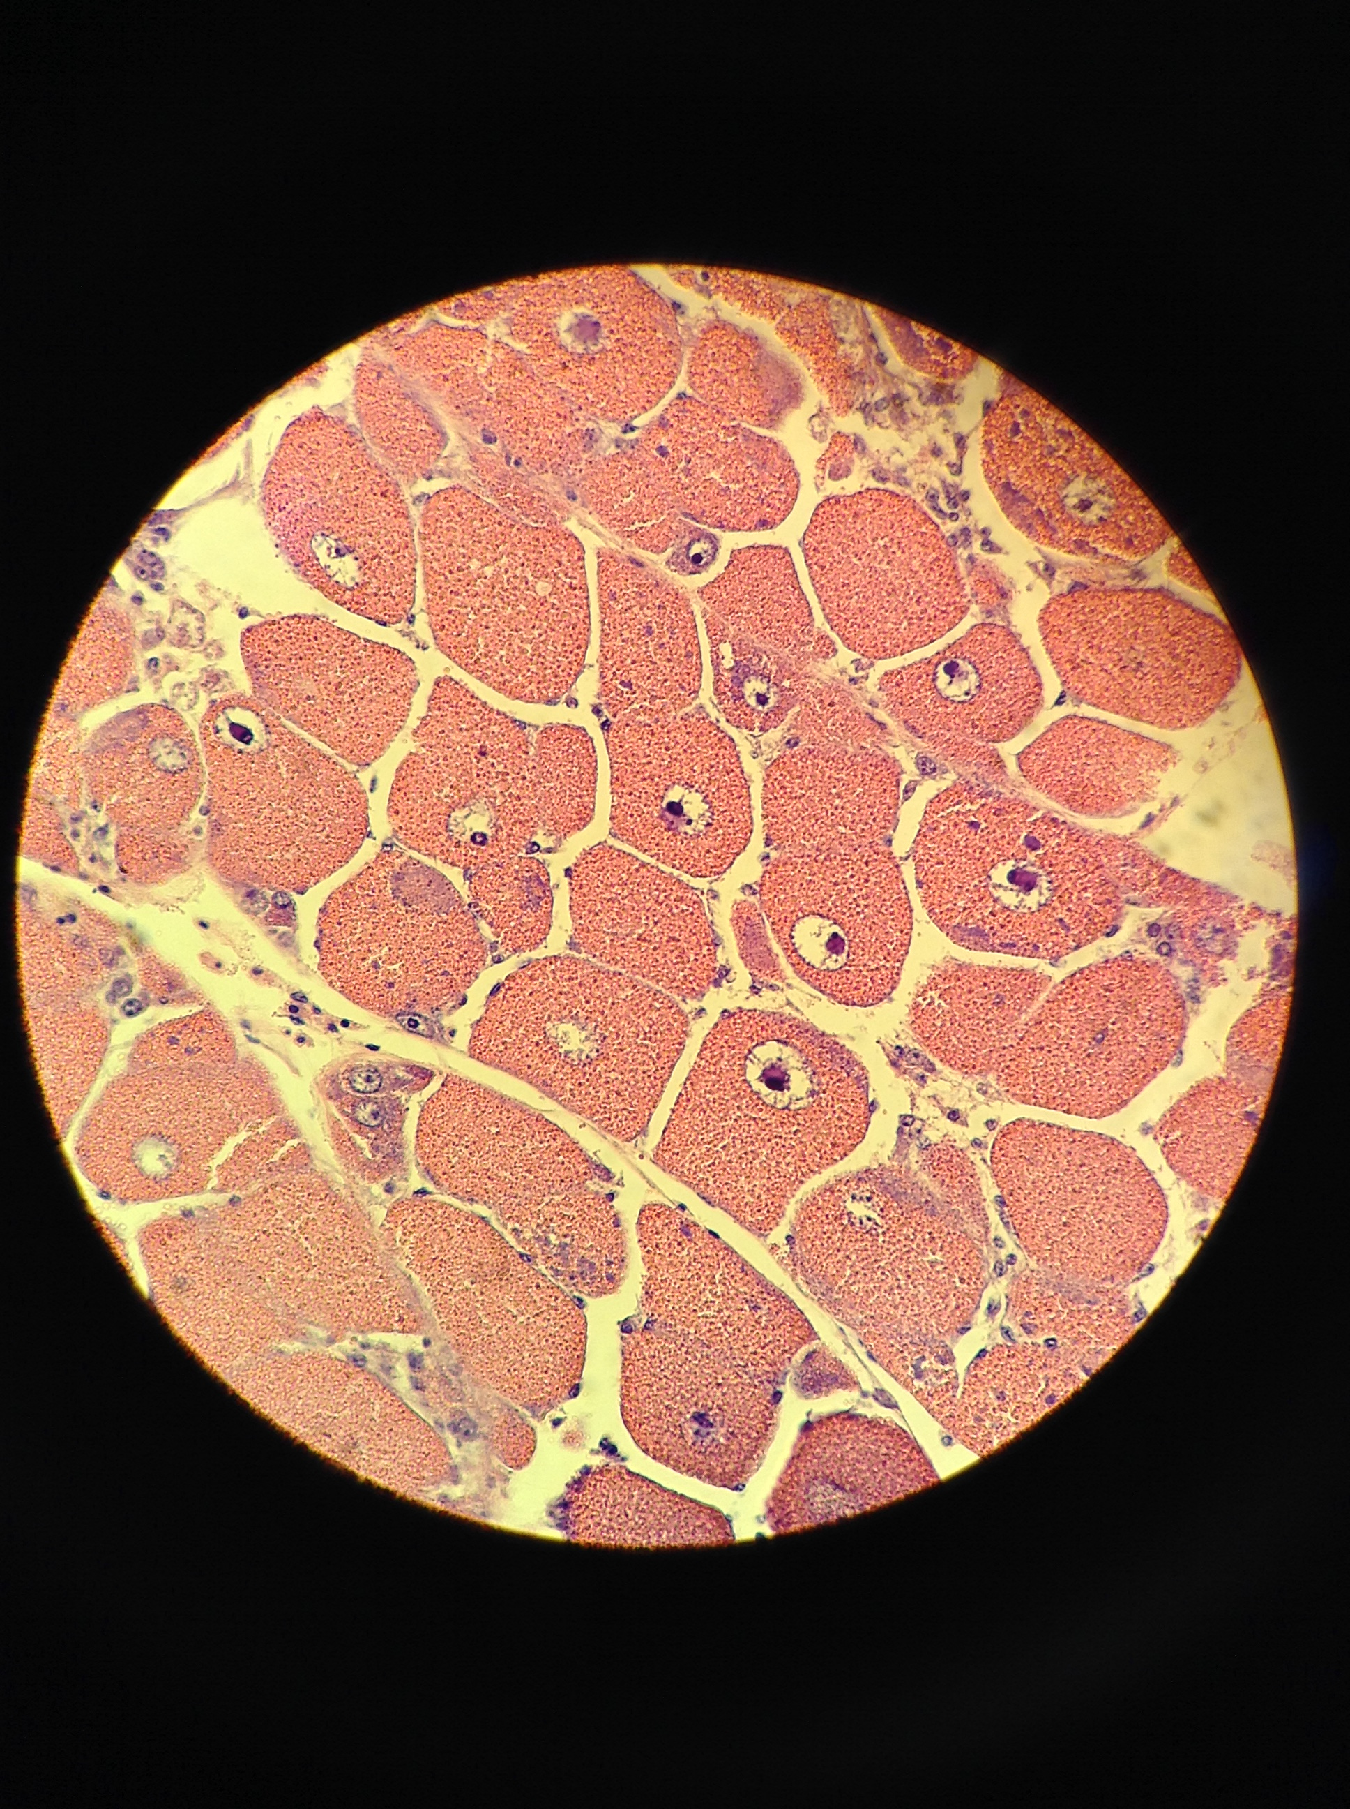
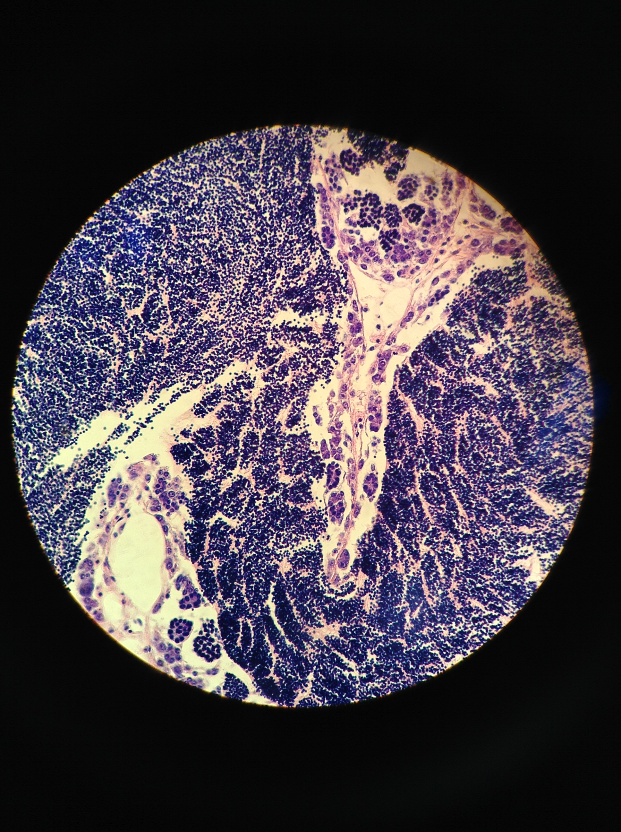
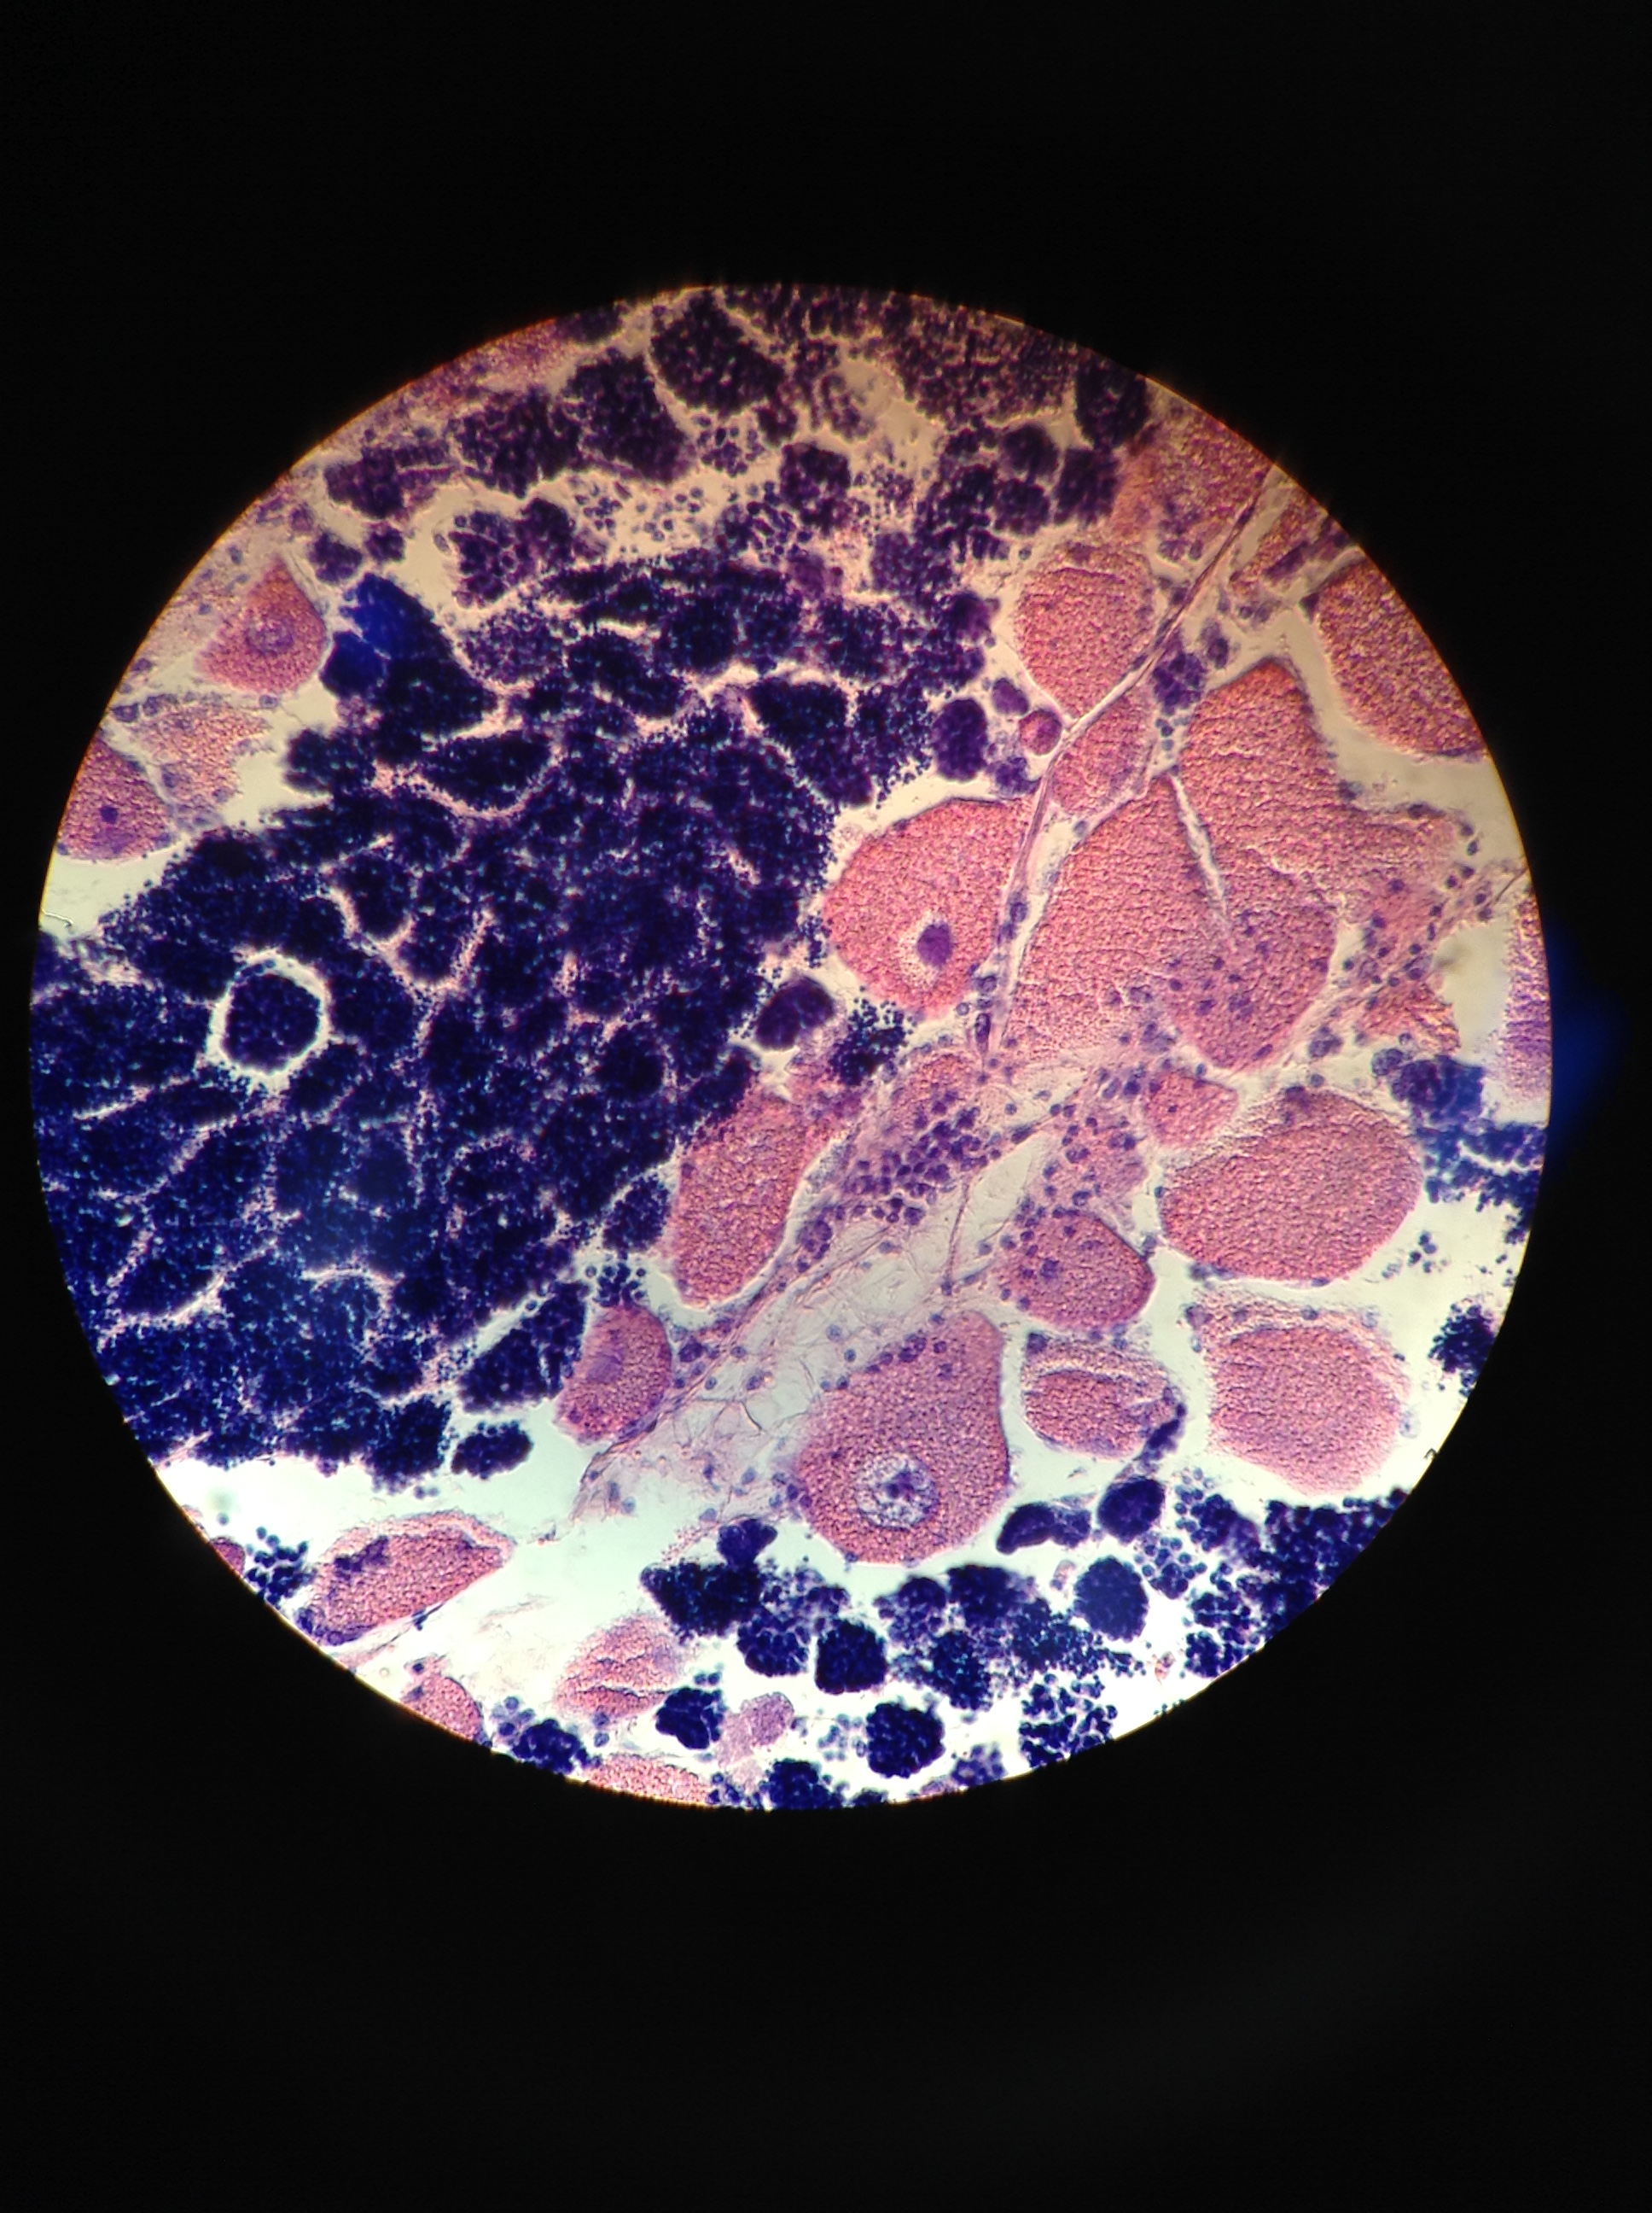
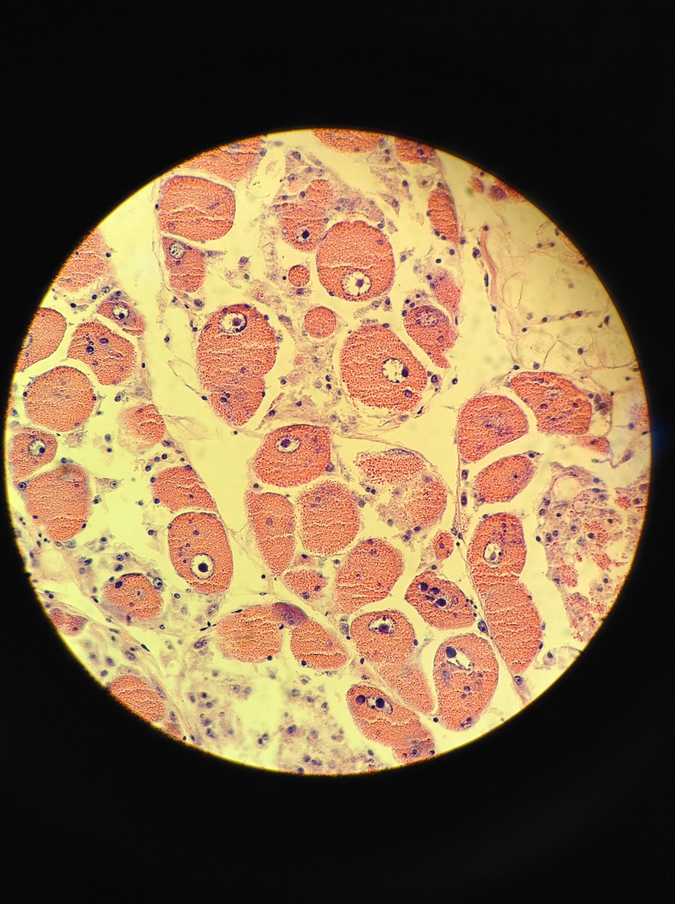
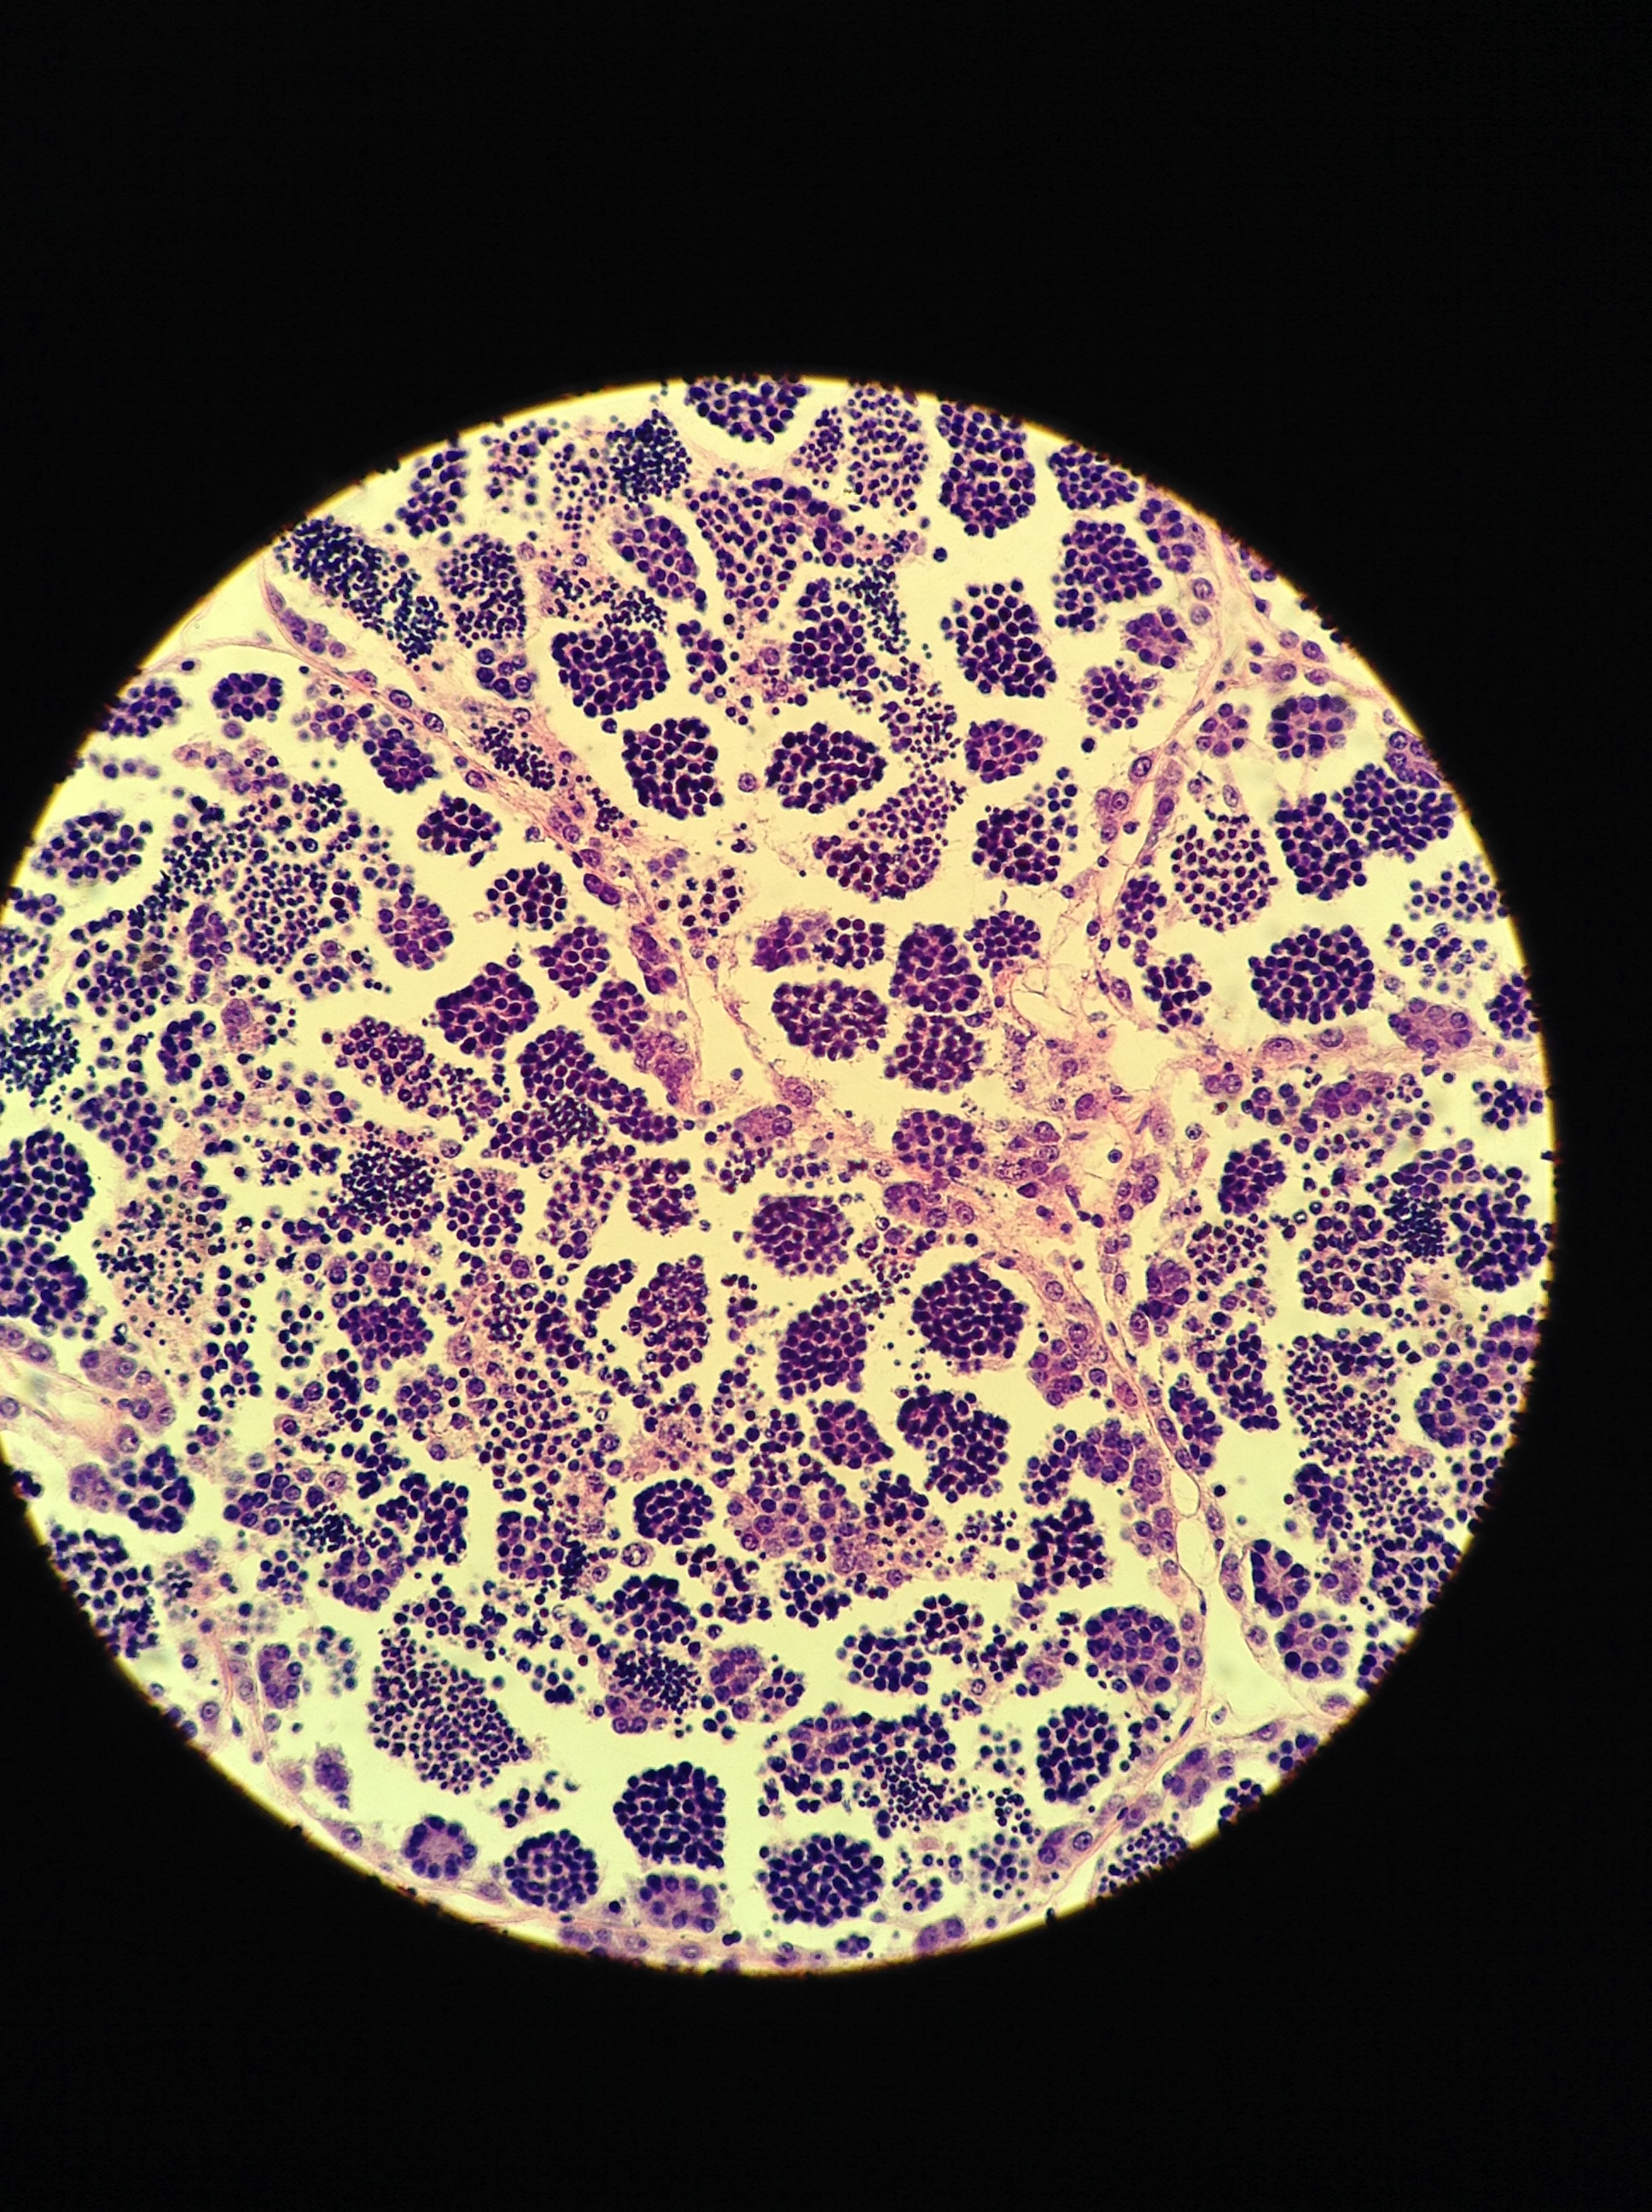
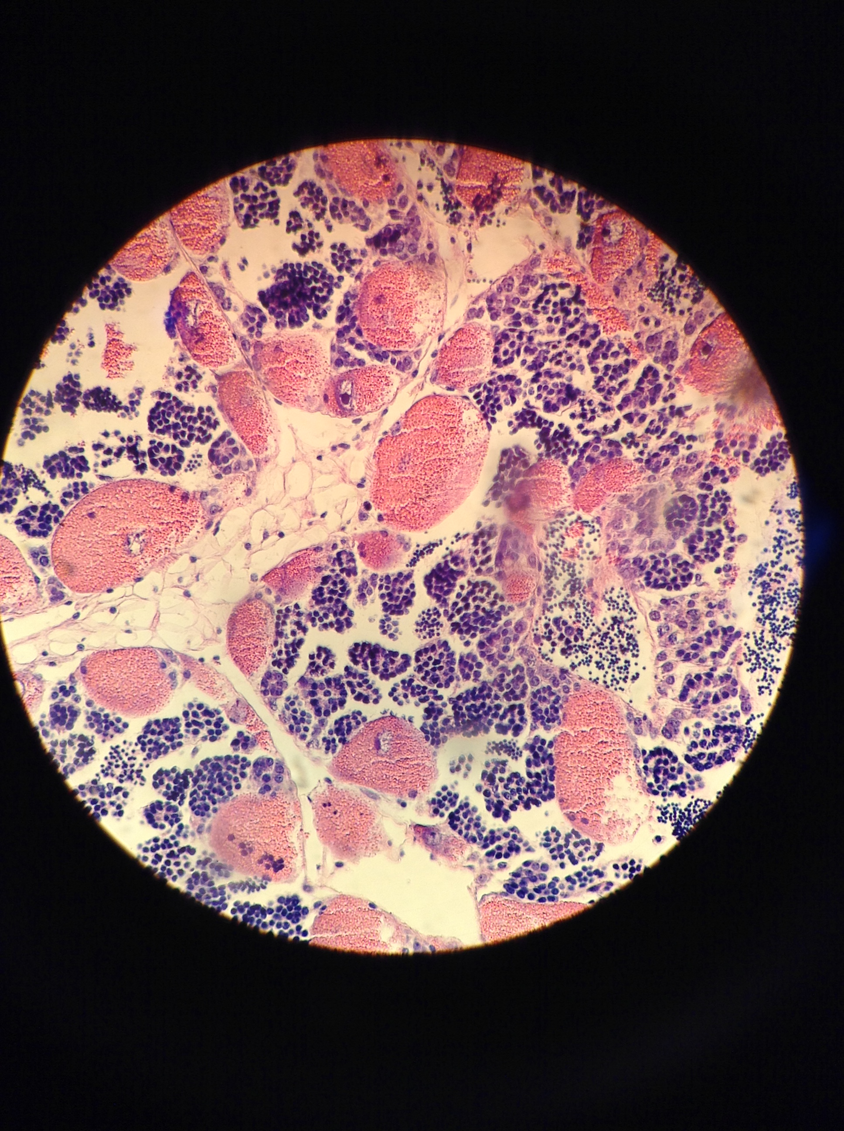
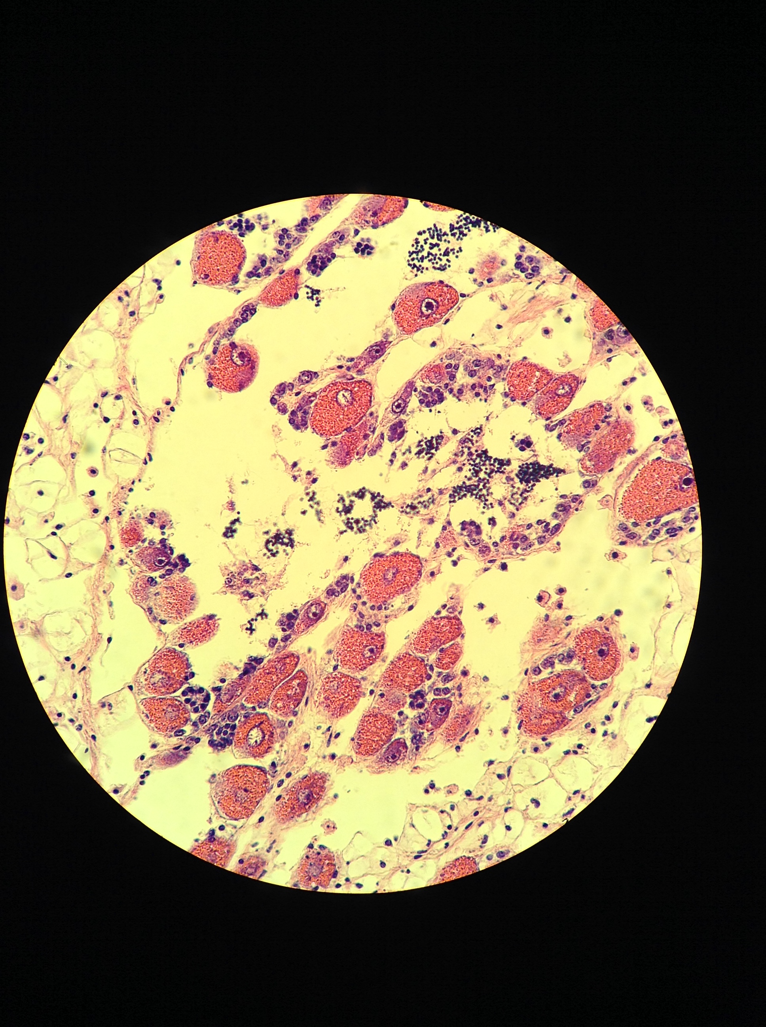
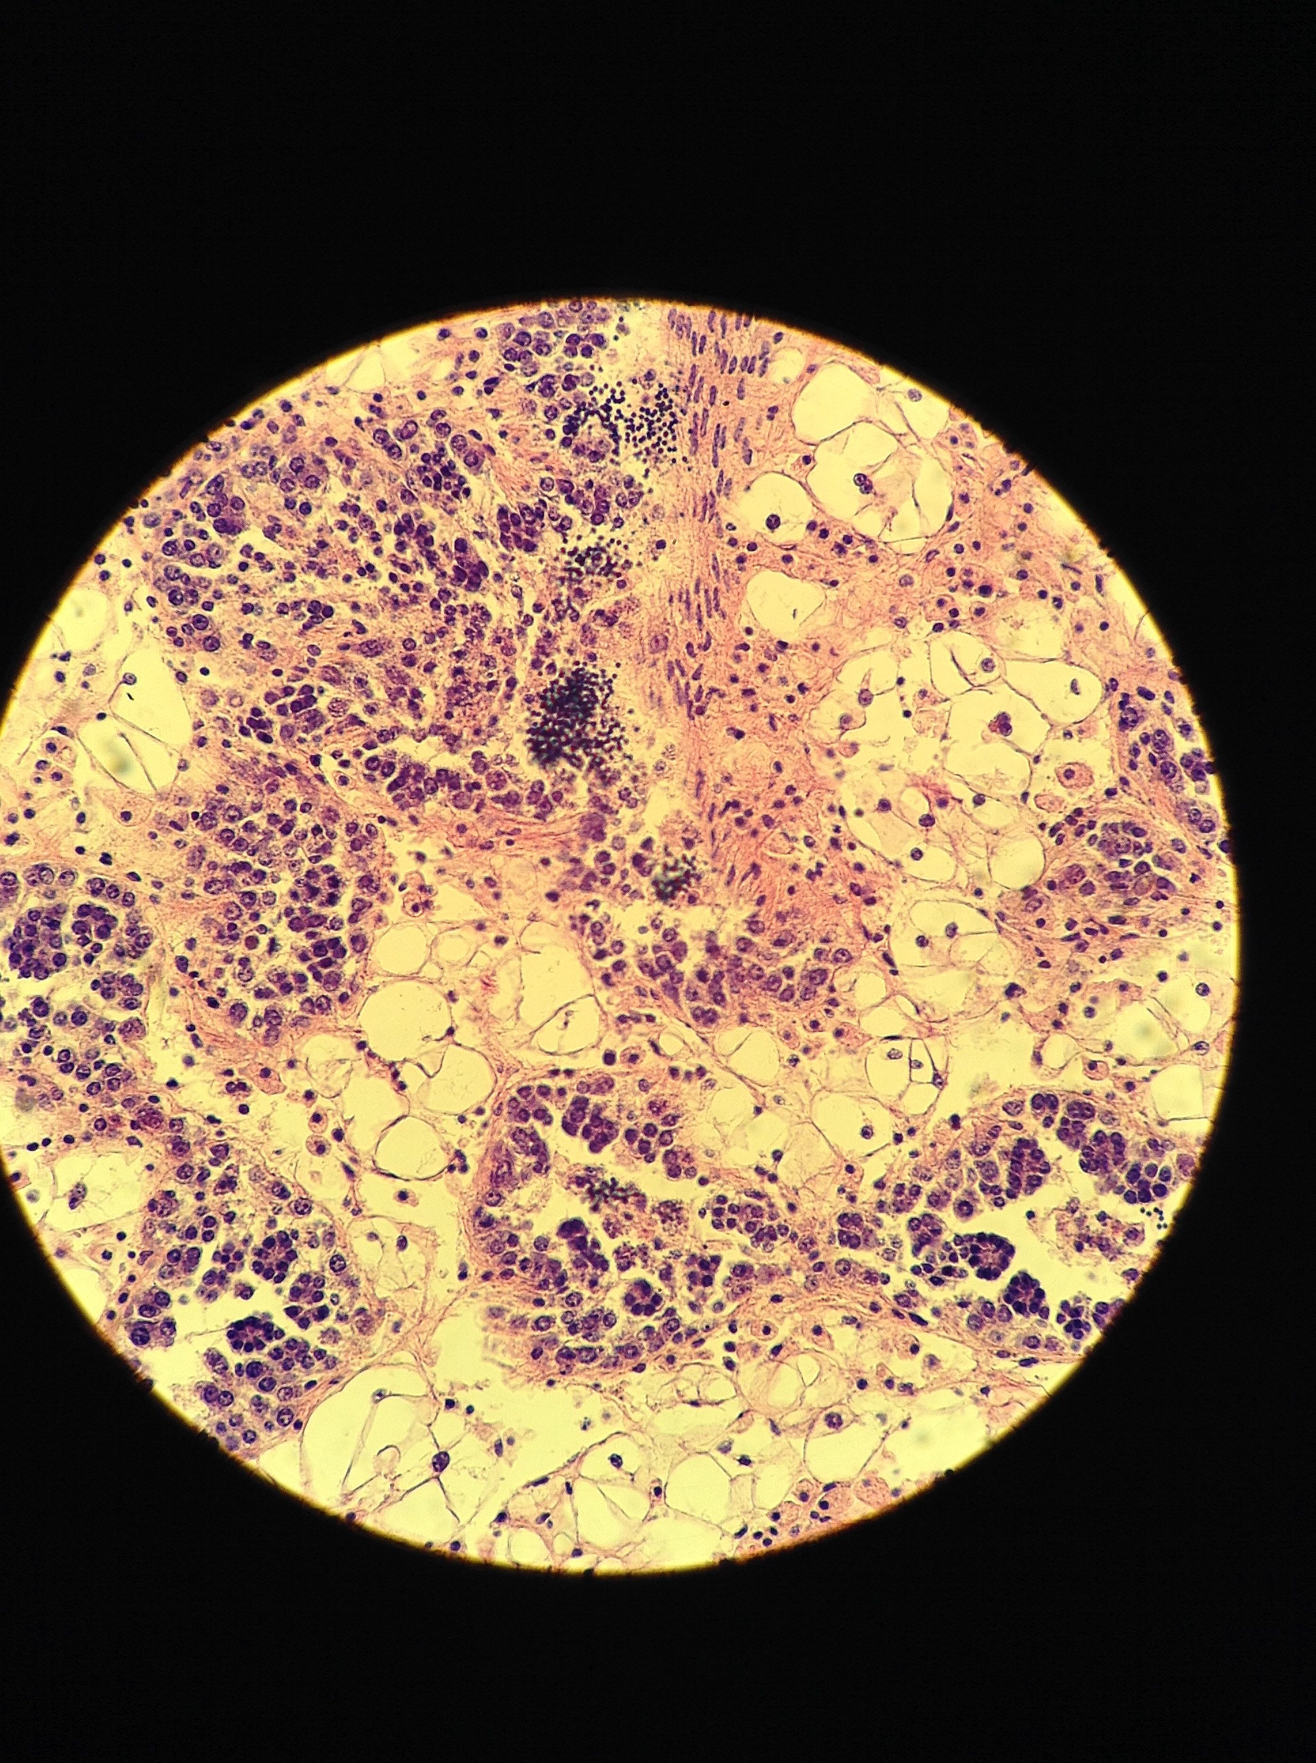
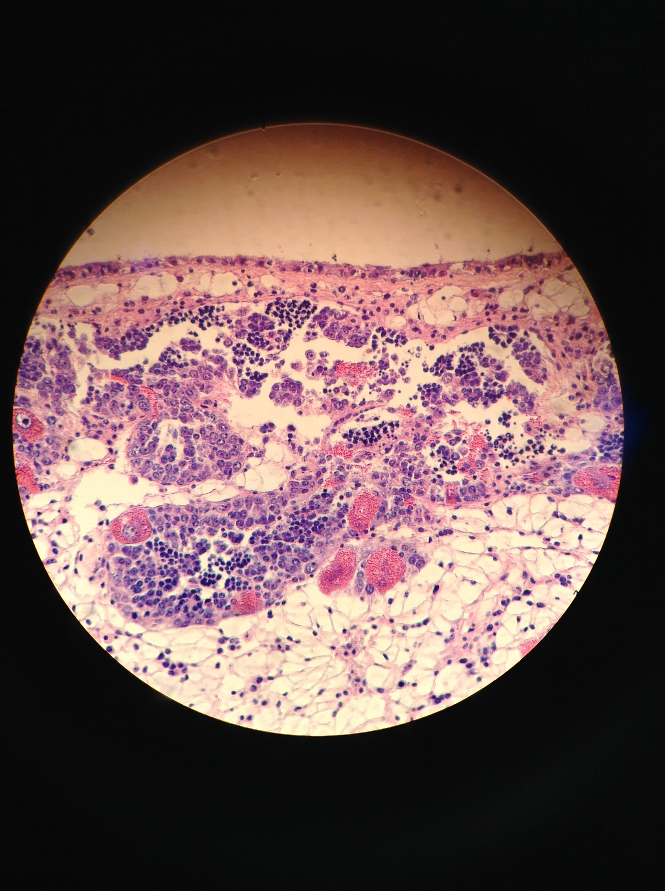
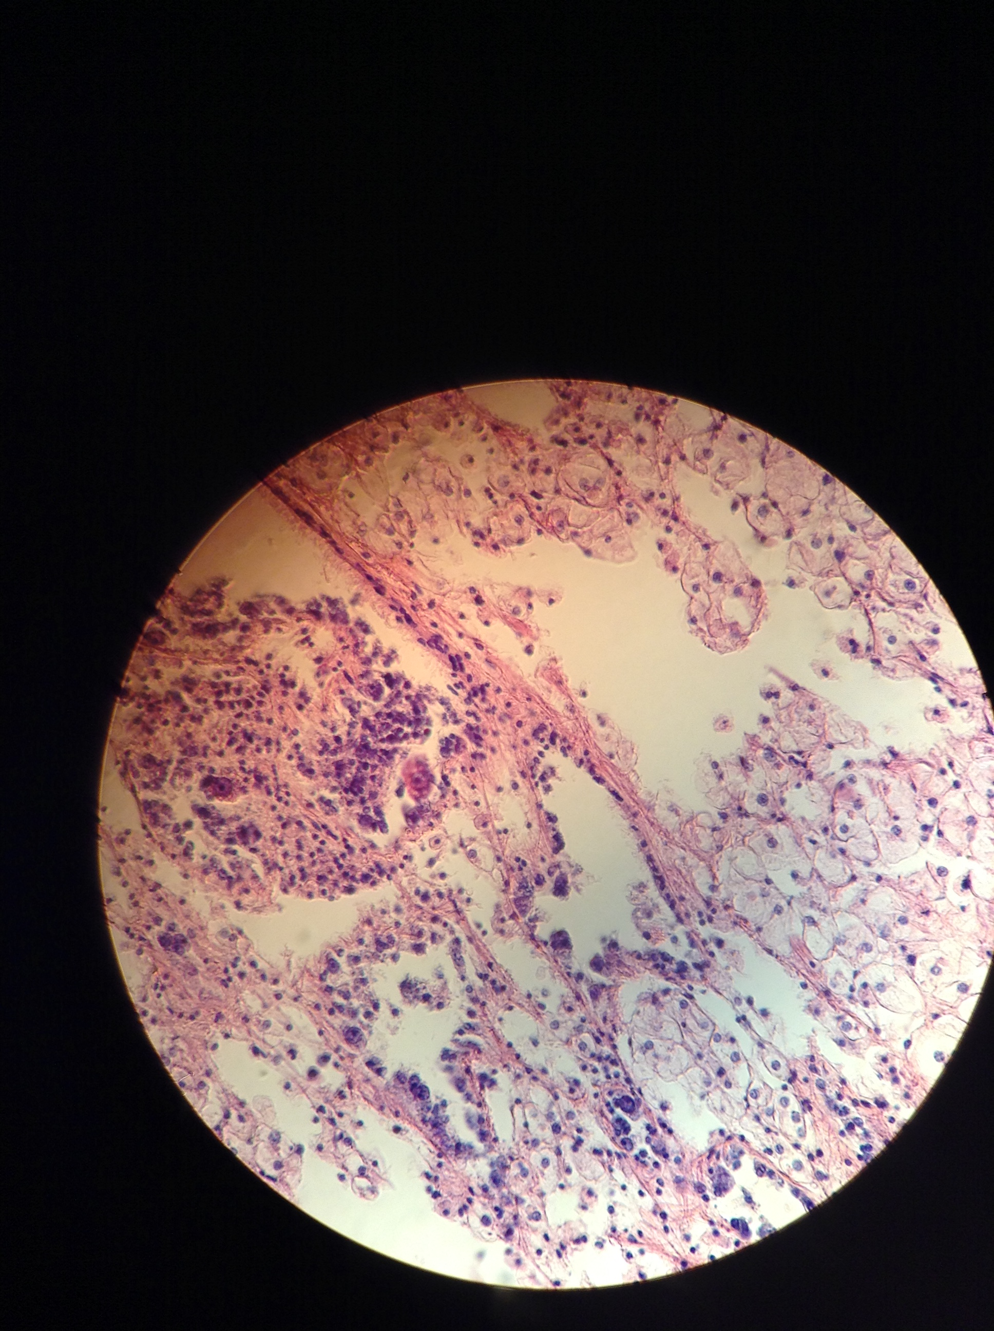
Female
Male
Hermaphroditic
4
None present
3
2
1
0
Notes:
Stage 4 male: NF6-#7
Stage 4 herm: NF6-#6
Stage 0: SN6-31

